Slide 1
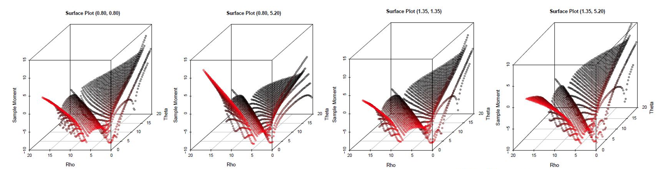
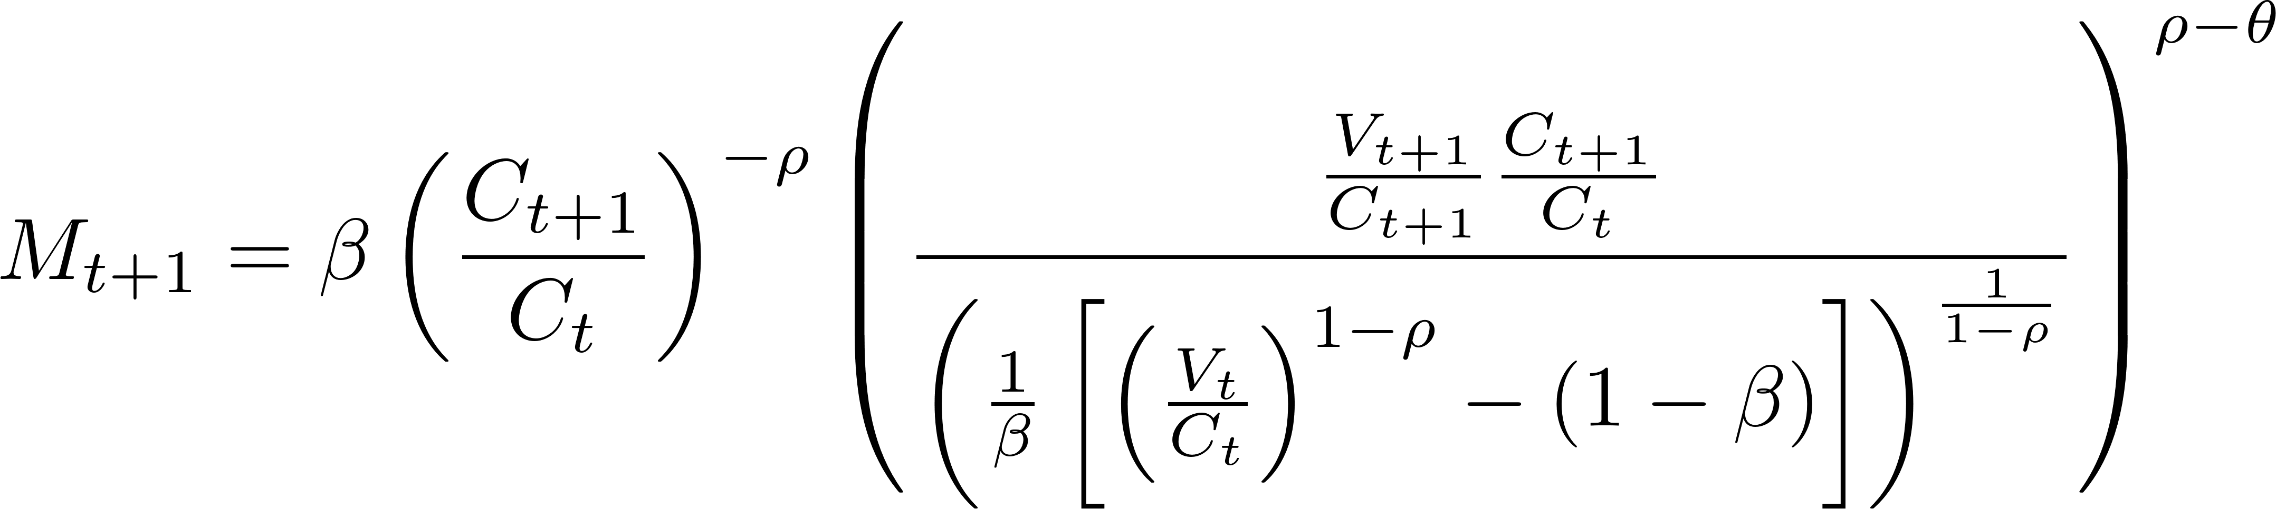
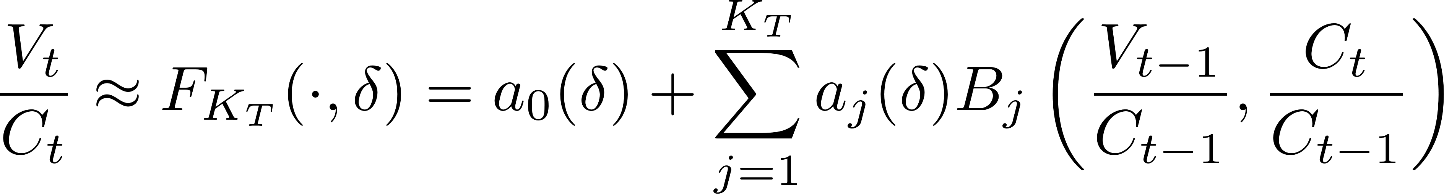
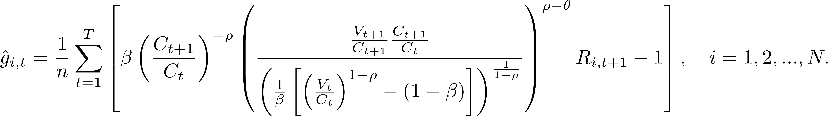
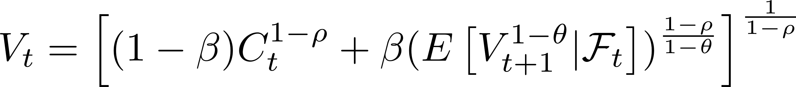
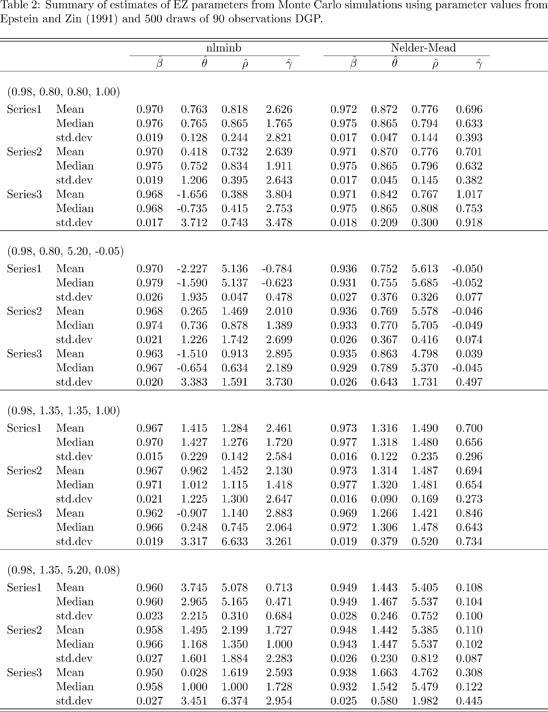
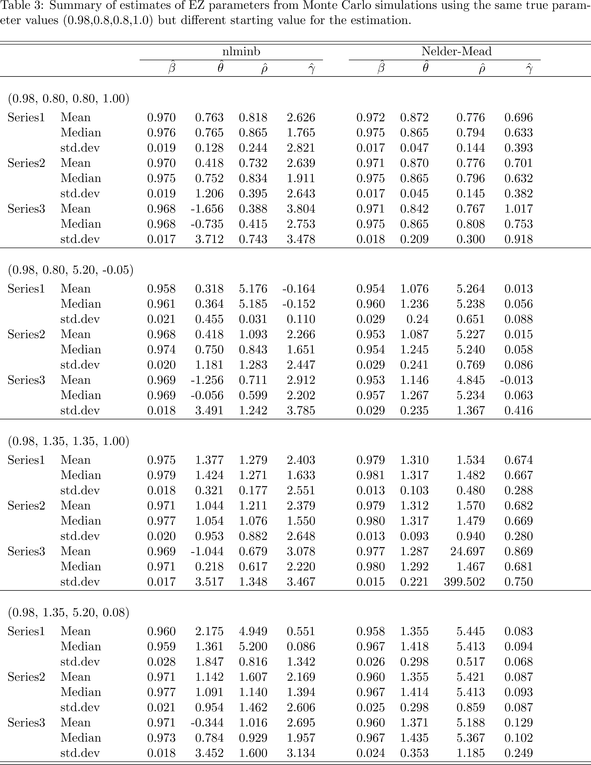
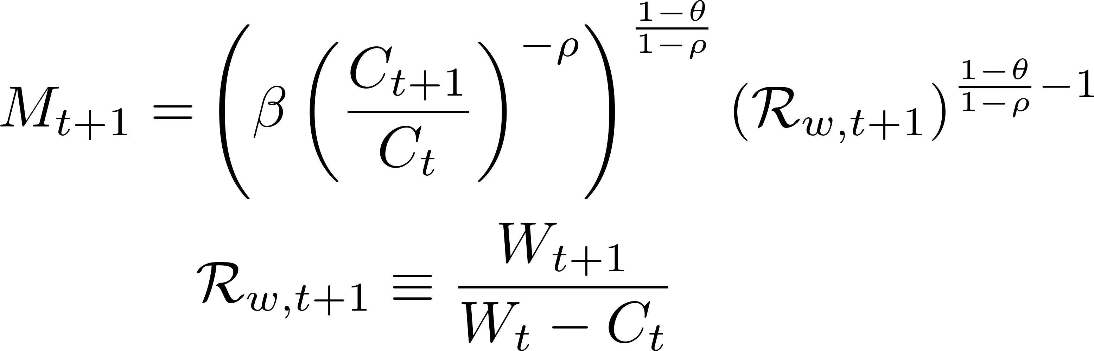
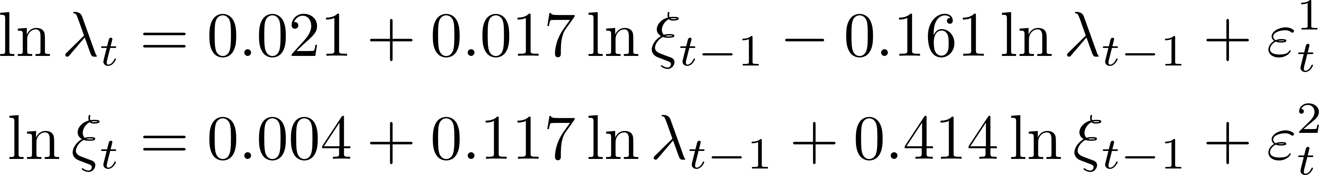
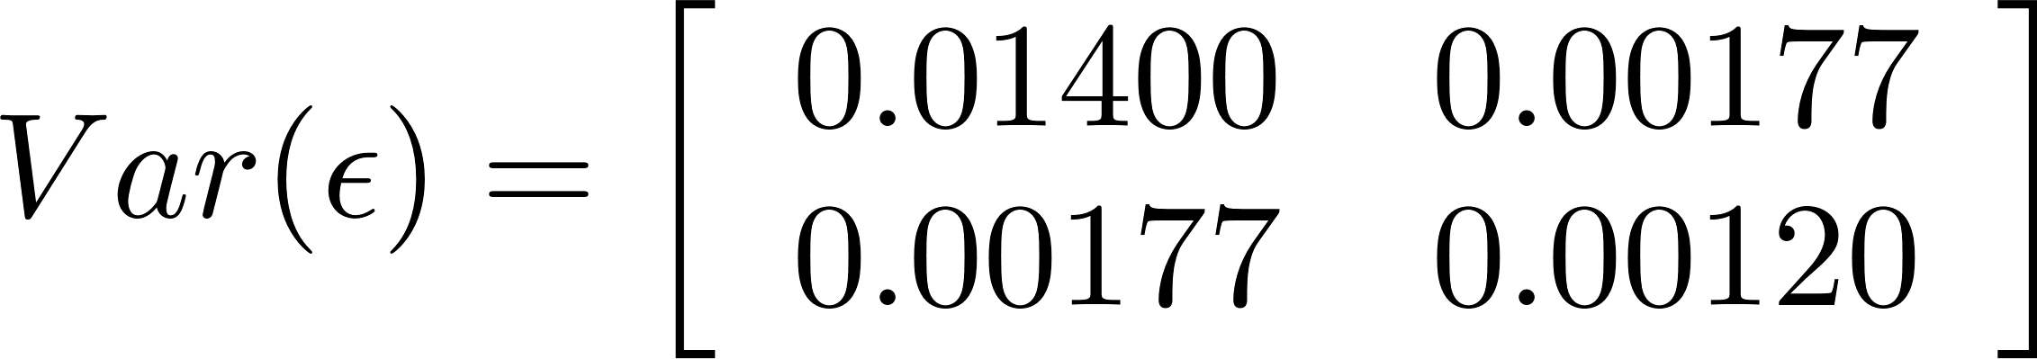
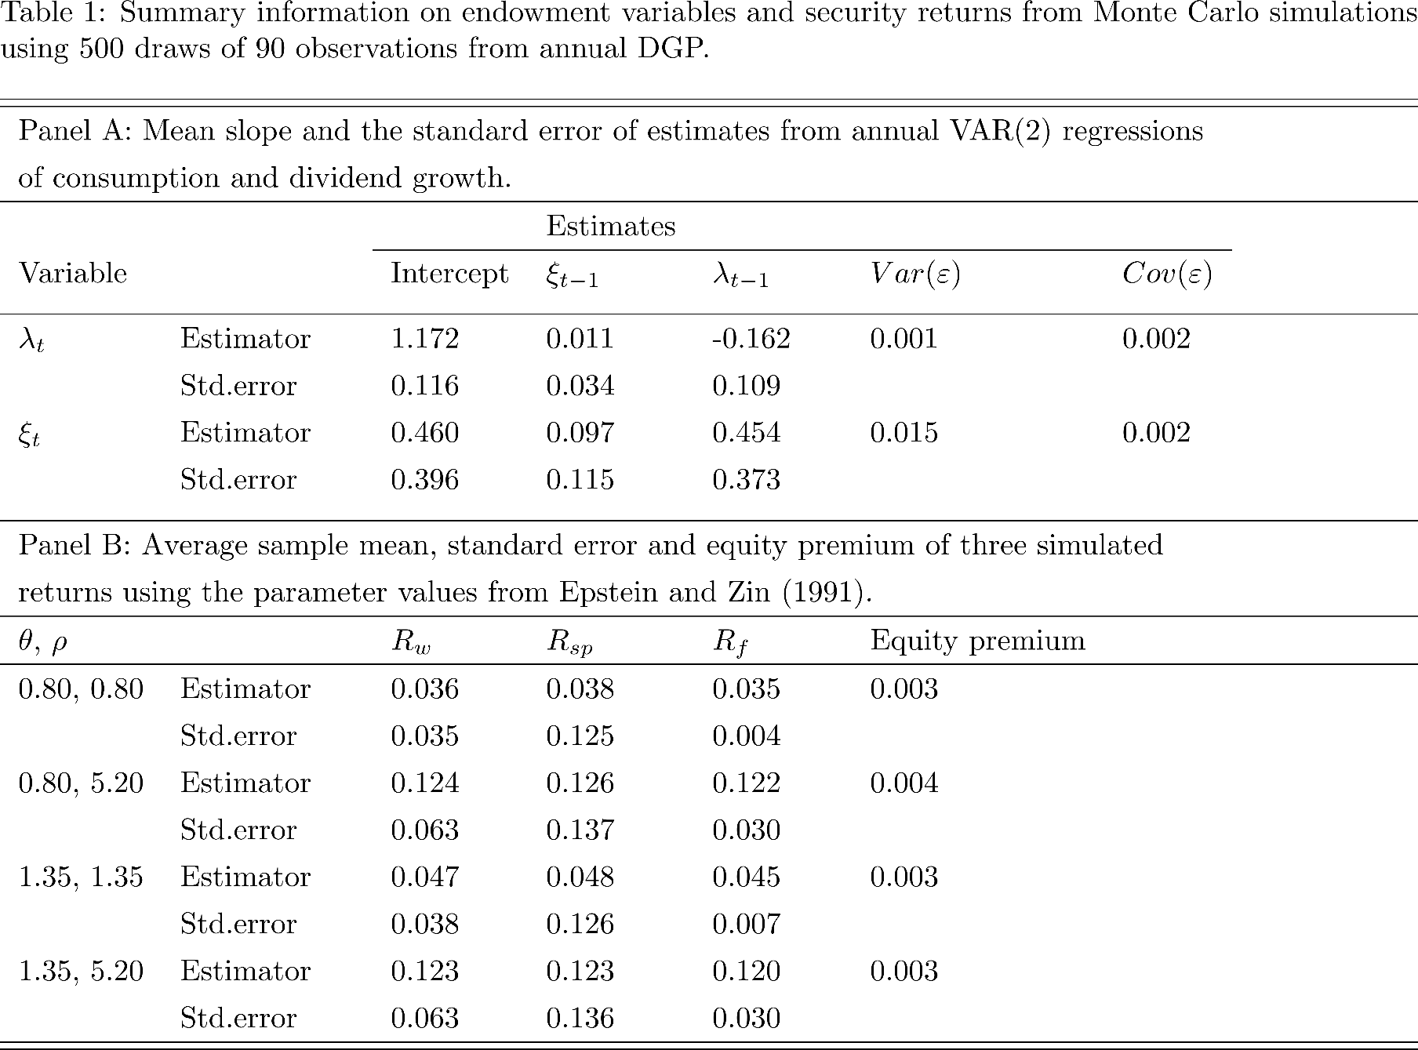
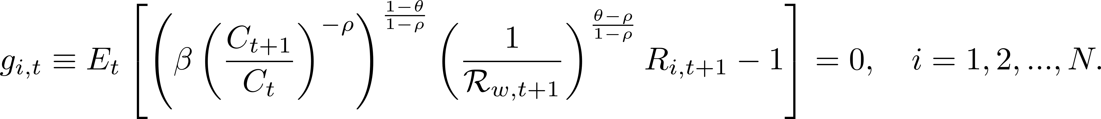
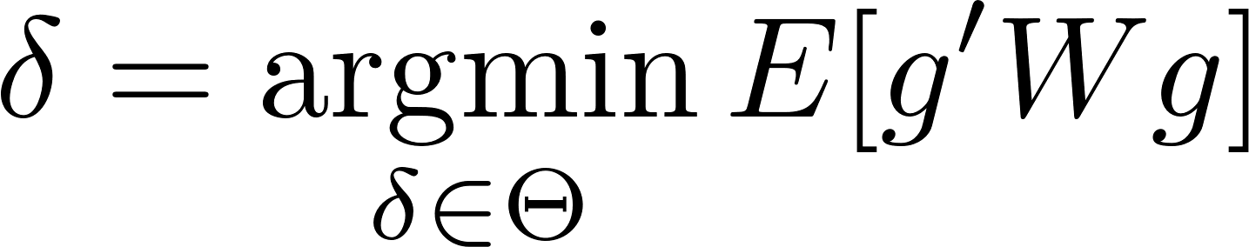

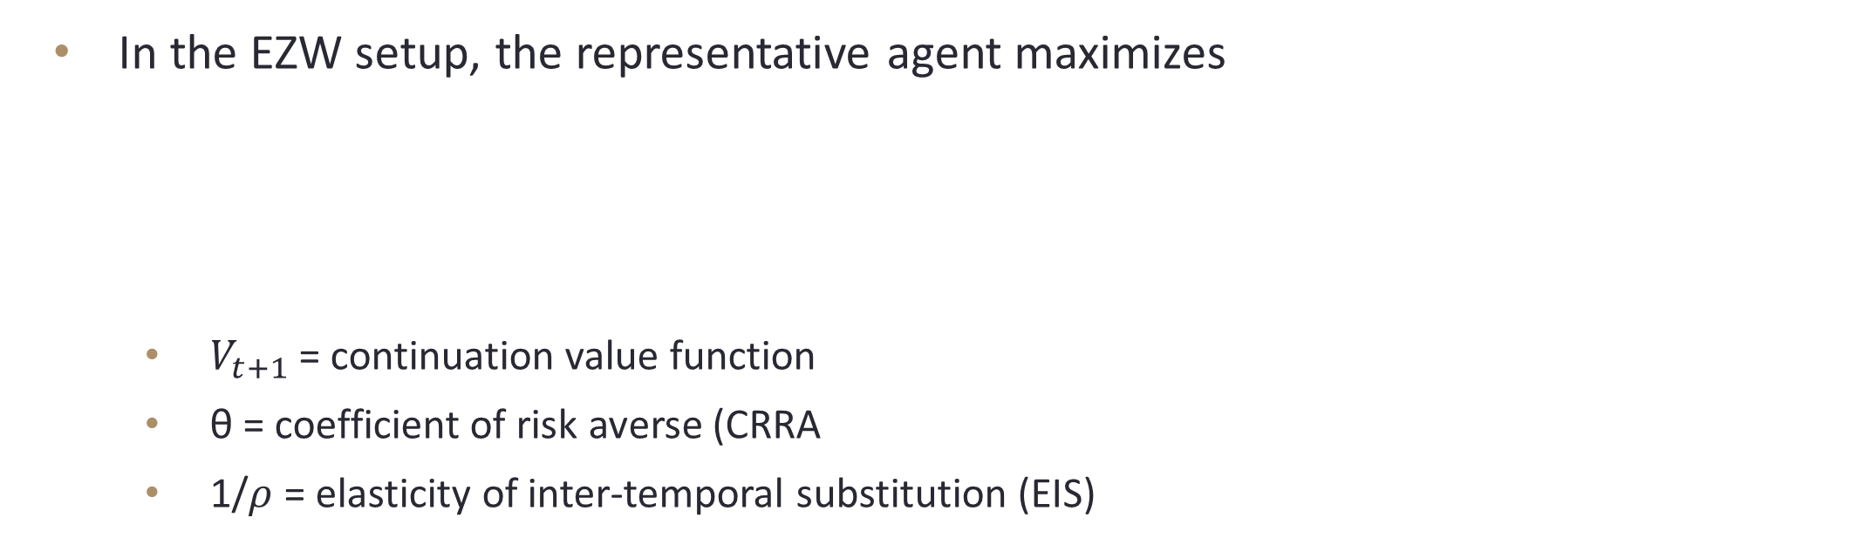


Are parameters in Epstein-Zin asset pricing model identifiable?
Zhonghui Zhang
University of Connecticut
Introduction
SMD approach
Surface of Gmm objective
This paper verifies the result of Smith (1999) that the generalized method of moment (GMM) estimators of Epstein-Zin recursive preference (EZW) model are poorly identified. Theoretically, EZW model can provide us more flexibility to distinguish the coefficient of relative risk aversion (CRRA) and the elasticity of intertemporal substitution (EIS), however, in practice, the GMM objective function cannot produce enough variation to identify each parameter no matter using real or simulated data.
I also apply the Sieve Minimum Distance (SMD) approach in Chen, Favilukis, and Ludvigson (2013), to verify this conclusion. During the application process, I find some technical issues of applying GMM method on nonlinear model such as EZW model. One frequent problem is non-numerical (either infinite or undefined) conditional moment could be generated for some combination of parameters. Another finding is that the recursive model tends to collapse to the standard time separable model during the estimation process.
The stochastic discount factor (SDF) is given by
Rather than finding an proxy for $V_{t}/C_{t}$, the $V_{t}/C_{t}$ is approximated as follows
The coefficients {$a_{1},a_{2},…,a_{n}$} depend on $δ$
The basis function {$B_{j}(∙,∙)$: j=1,…,$K_{T}$} have known forms independent of $δ$.
The GMM moment condition is
Given an initial value of $\left\{β,θ,ρ,\frac{V_{0}}{C_{0}}\right\},$ we can first estimate $F_{KT}$ by
Once the approximation ${\hat{F}}_{KT}$ is given, the parameters $δ≡\{β,θ,ρ\}$ are estimated by
Two optimization algorithm
Gradient-based algorithm, known as nlminb in R
Gradient-free algorithm, known as Nelder-Mead in R
The second algorithm can be considered as direct search by using a nonlinear simplex
It avoids the second order derivative but pay the price of longer computation time
EZW model
results
In the EZW setup, the representative agent maximizes
$V_{t+1}$ = continuation value function
θ = coefficient of risk averse (CRRA
1/$ρ$ = elasticity of inter-temporal substitution (EIS)
Proxy approach
Data
The stochastic discount factor (SDF) is given by
The GMM moment condition is
Then the parameters $δ≡\{β,θ,ρ\}$ are the minimizer of the standard sandwich form
$R_{w,t+1}$ = return to aggregate wealth
$g=(g_{1},g_{2},…,g_{n})$ is the vector of moment conditions
W $=$ weighting matrix.
Simulation data are generated follows Smith (1999) by the following VAR(2) estimates
$λ_{t}=c_{t}/c_{t−1}$ is the consumption growth
$ξ_{t}=d_{t}/d_{t−1}$ is the dividend growth
conclusions
Some widely used GMM moment condition, particularly in the case of the nonlinear model, may be well defined theoretically but may not have a numerical result
Most computer algorithm requires a given starting point, this may lead to a result that the estimates are close to the starting point when the surface of the objective function is flat. In another word, the estimates highly depend on the initial values
GMM method using lagged endogenous variables as instruments may suffer from the collinearity problem. Simply drop instruments may lead to larger measurement error

